Slide 1
Wildlife Friendly Traveler
Educating the International Shopper
Charles Huang
Shelley Morris
James Punteney

Slide 2
Problem Statement
Make it easy for travelers to identify what they should avoid purchasing when they travel.

Slide 3
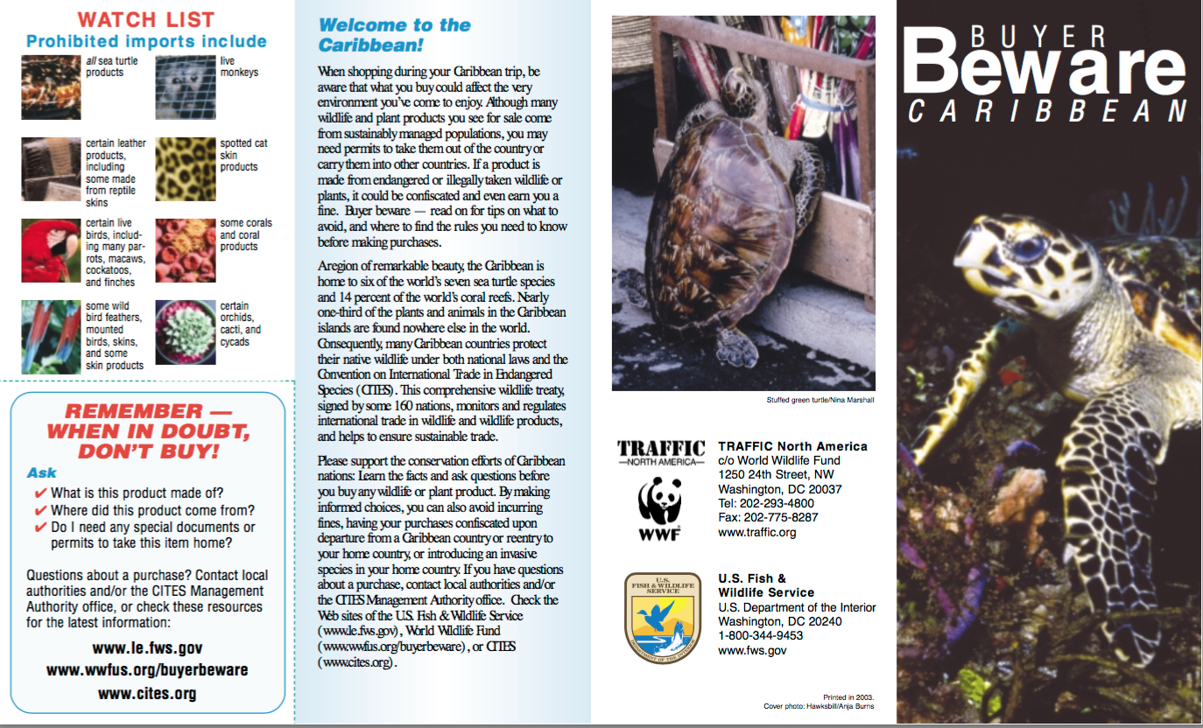
Information is out there, but...
Information is condensed in wordy reports or in PDF brochures
Information is scattered across many sites and organizations
Information is organized for scientists, not travelers

Slide 4
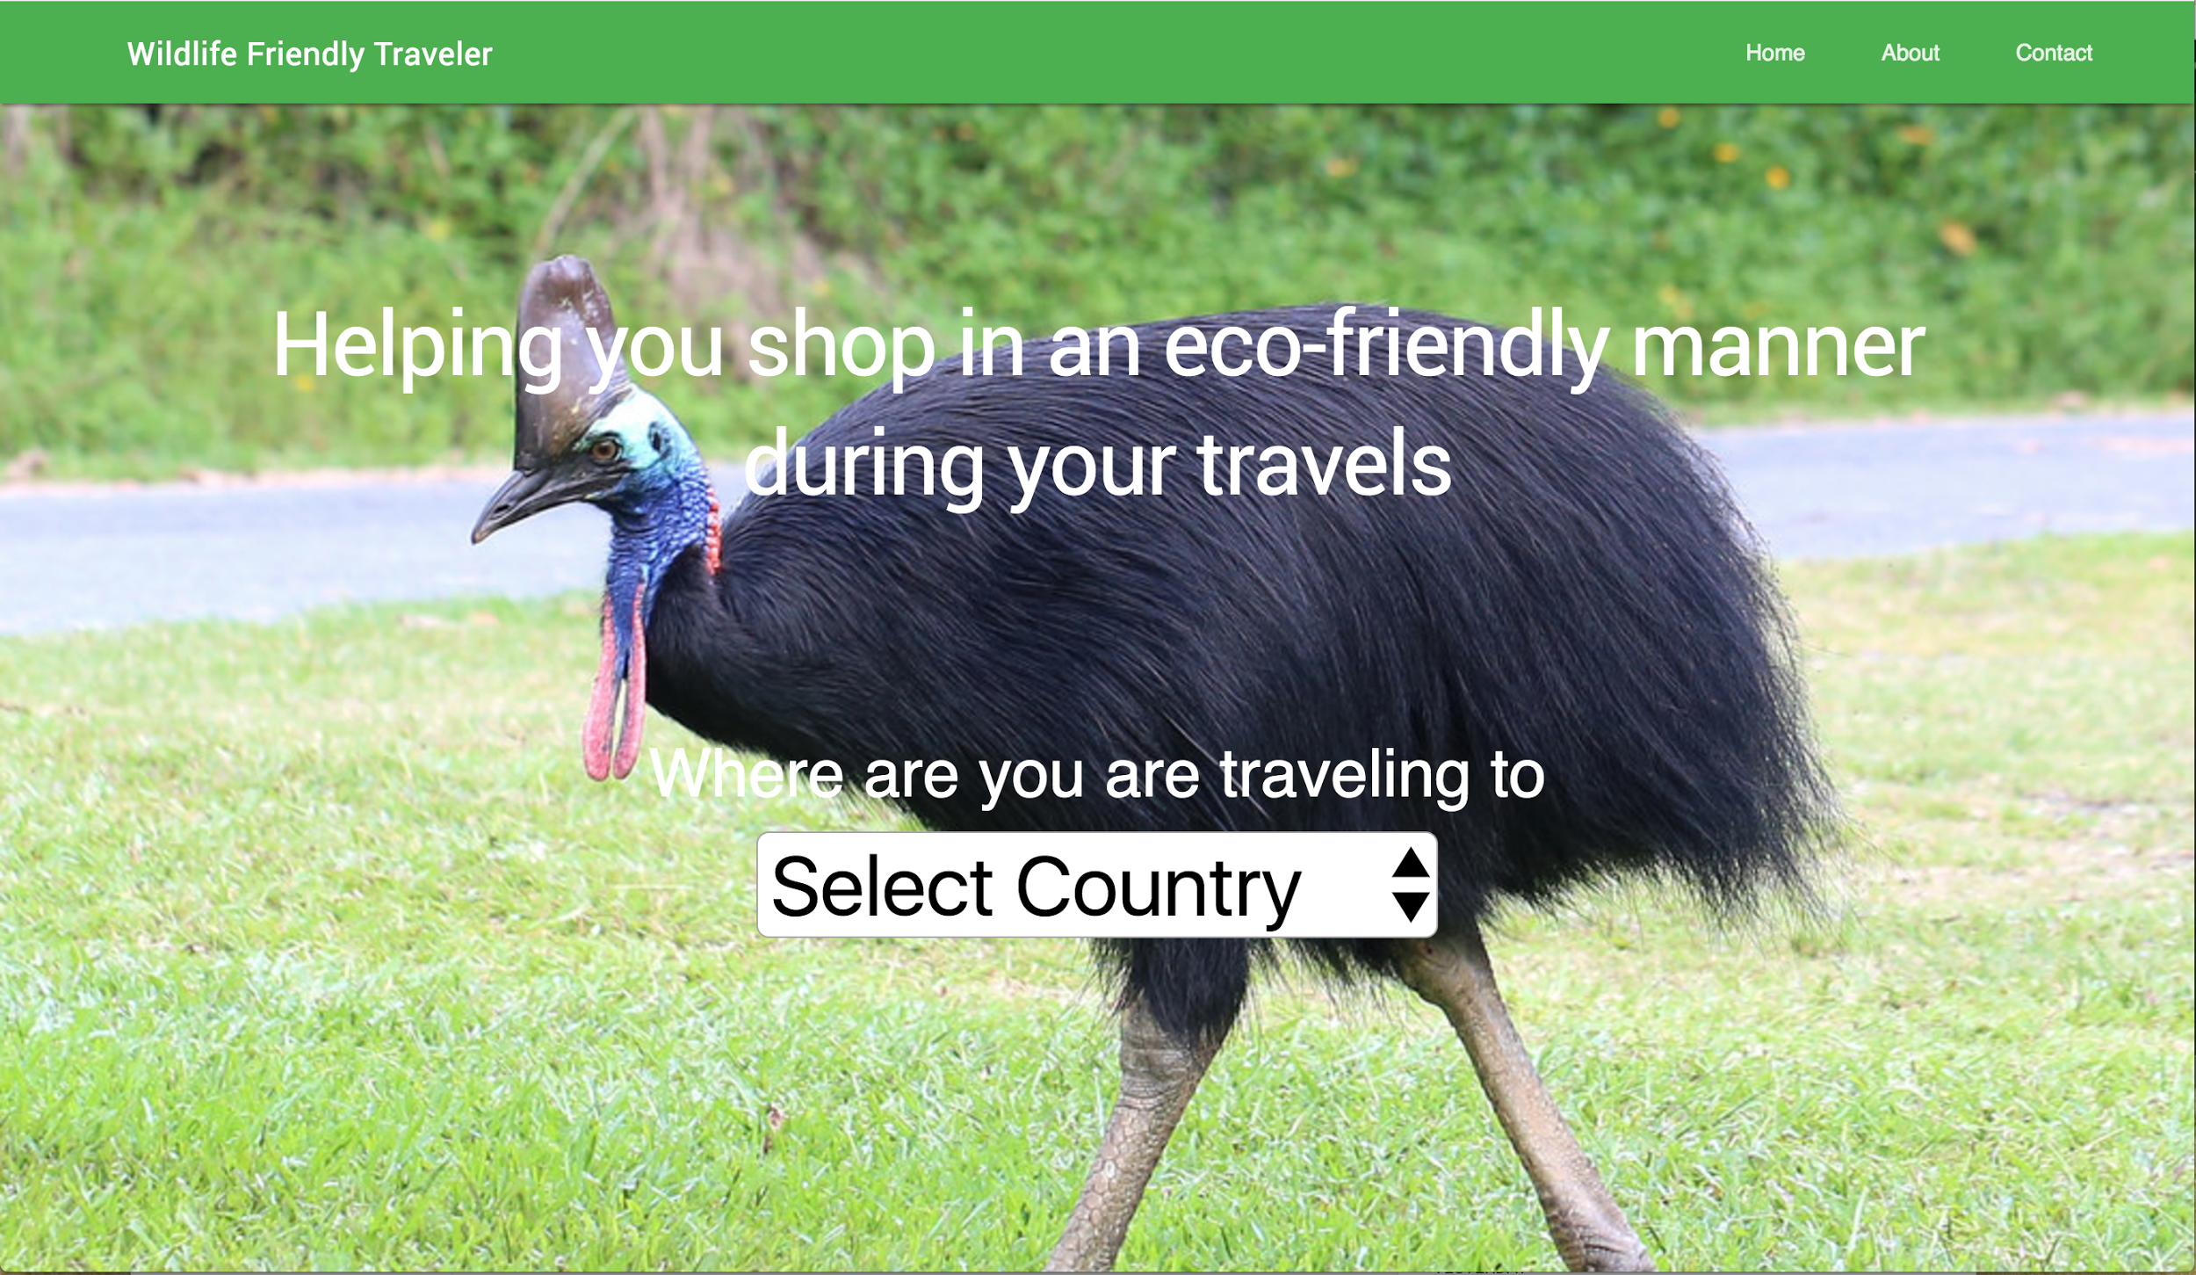
Notes:
Easy place for users to go where they can enter in their country of travel, and get easily readable results on what they should avoid while they’re in that country.

Slide 5
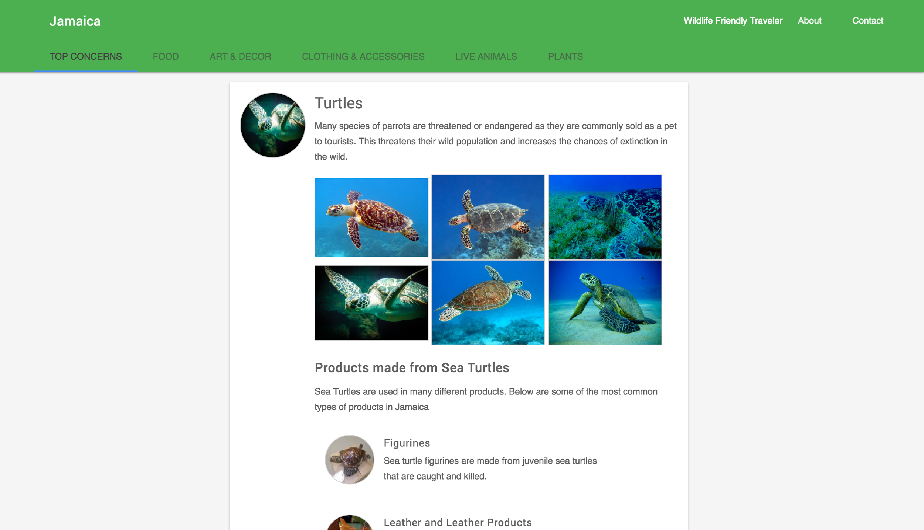
Notes:
In this example, we select Jamaica. We see the top concerns of that country by default, but can easily select a tab for more information on particular items, such as Food, Art & Decor, Clothing & Accessories, Animals (Pets), and Plants.

Slide 6
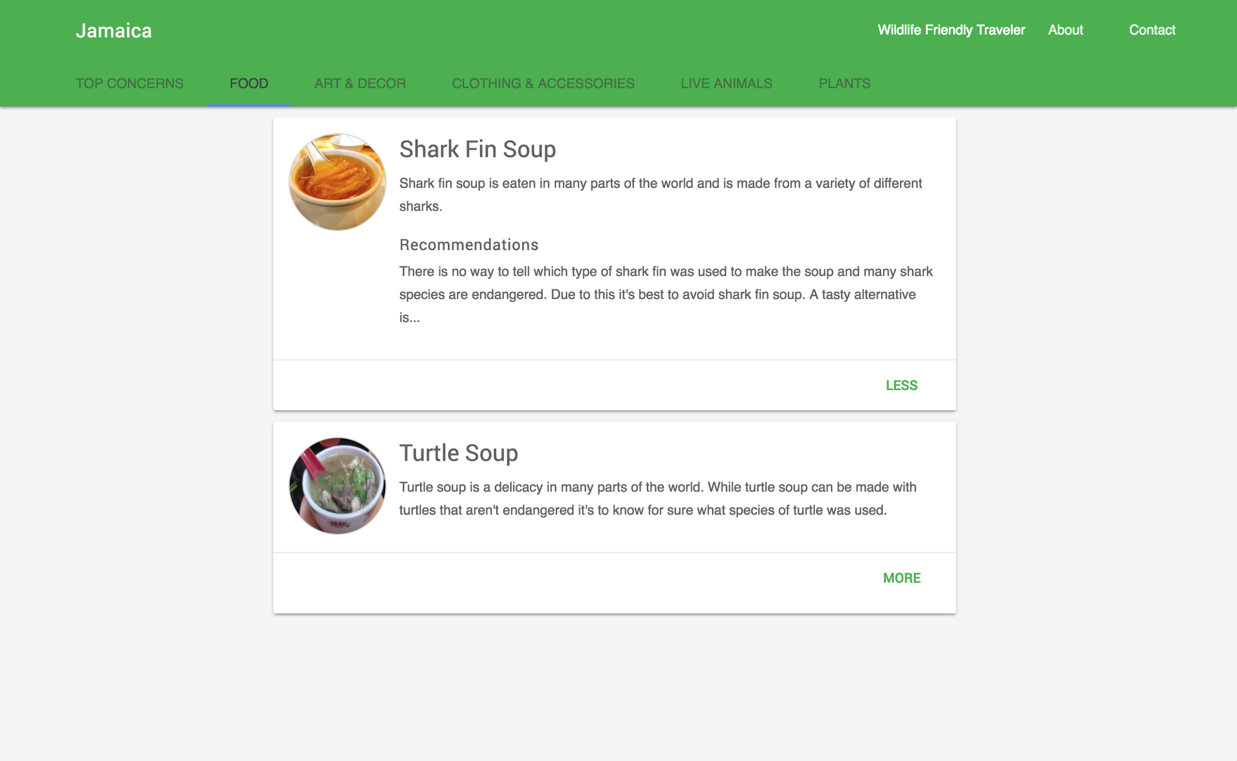
Notes:
Here, we select on the food tab, to see what we should avoid eating while in Jamaica.

Slide 7
Use Cases
Cruise Traveling (Incorporate this information into Cruise Shopping Seminars)
Appended information to flight tickets
JetBlue Video / Awareness (Point to this web app)
Mobile App Version
Tied into shopping apps

Slide 8
Resources Needed to Continue
More research is needed (the perfect intern project!)
Add more items to each card, integrate more sources

Slide 9
Impact
More informed Consumers
Decrease in demand for products that play a part in wildlife trafficking

Slide 10
The Code
GitHub: https://github.com/charleshuang80/WlidlifeFriendlyTraveler
Heroku: https://wildlife-friendly-traveler.herokuapp.com/

